Slide 1


Southeastern District
Solo and Ensemble MPA Festival
Midway High School
Joshua Tew, Chair
Joshua Tew and Jesse Shelton, Hosts

Slide 2
What is Solo and Ensemble MPA Festival?
Solo and Ensemble Festival is a great way to challenge your instrumentalists and encourage your developing musicians. Performing as a soloist helps students improve on their instrument while fostering confidence and poise. Chamber music (duets, trios, quartets, quintets, etc.) allows students to support a part on their own which develops individual rhythm, intonation, phrasing, listening, and more.

Slide 3
What do students play at the festival?
There is no required list of solo and ensemble repertoire in North Carolina. Solos can be accompanied or unaccompanied with live instruments, or CD, etc. The Rubank Publications are useful for this type of festival (Concert and Contest Collection for all instruments, duet and trio collections, etc.). J.W. Pepper and many other websites have entire catalogs dedicated to Solo and Ensemble literature.
Click here to view some great sheet music resources.

Slide 4
Who can play at the festival?
Students of any age or instrument! We’ve even had string players come and participate in our Solo and Ensemble in the past. Beginners are invited just as much as advanced players!
Younger musicians are certainly welcome to play out of their school method books for the event. Please encourage your students to get involved in this individual and small group activity that can make a wonderful difference in their playing and self-confidence. We want this to be a positive experience for every participant.

Slide 5
Cost
Solo and Ensemble is an inexpensive festival!
  Solos- $10
  Duets- $10
  Ensemble (Trio or larger)- $10
  There is no limit to the number of events that a student can participate in during the festival. Students can play solos, and also play in other groups. Just be sure to pay the appropriate fees.

Slide 6
Adjudication
SEDBA directors are not expected to judge the event.
Judges outside of SEDBA are hired to judge the event.
Each solo or ensemble will be adjudicated by one judge. Each solo or ensemble will be judged using the state adjudication sheet.
Ratings will be nearly instant. Ratings will be posted in the atrium following each solo or ensemble’s performance.

Slide 7
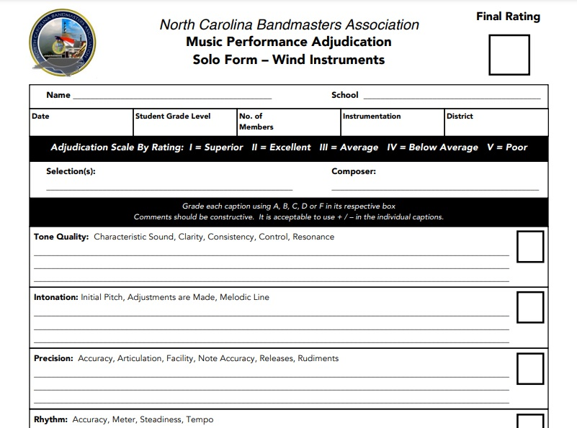
Adjudication

Slide 8
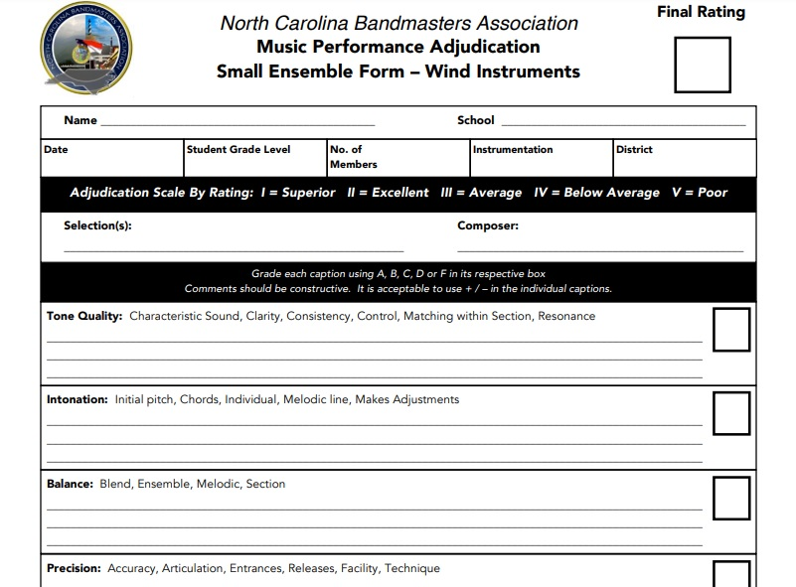
Adjudication

Slide 9
Director Procedures (Prior to day of)
All registration will be available online on the SEDBA website. https://www.ncsedba.org/solo-ensemble
Directors must mail the required fees by 1 month prior to the event. This means that it must be postmarked 1 month prior.
Directors must make a photocopy of student music for the judge to view while students are performing.
Prior to the festival day, participating directors will receive an e-mail that contains the schedule for the day. Every effort will be made to meet director’s scheduling needs.

Slide 10
Student Procedures (Day of)
Arrive on campus and report to the gymnasium to warm-up.
Students will be called to report to their performance room. Student must take their copy of music AND the judge’s photocopy to view during performance.
Students will then perform, exit the room, and then report back to the gymnasium.
There will be snacks available for purchase in the cafeteria.
Every participating student will received a certificate.

Slide 11
Join us for the SEDBA Solo & Ensemble MPA festival!
Midway High School
Joshua Tew, Chair (jtew@sampson.k12.nc.us)
Joshua Tew and Jesse Shelton, Hosts

